Slide 1
EE463
Static Power Conversion
Hardware Project Feedback Presentation
Ömer Şen
Gamze Çelik
Mehmet Emre Doğan

Slide 2
Outline
Problem Definition
Topology Selection
Simulation Result
Targeted Bonuses
Calculations
Component Selection
Thermal Calculation
Conclusion

Slide 3
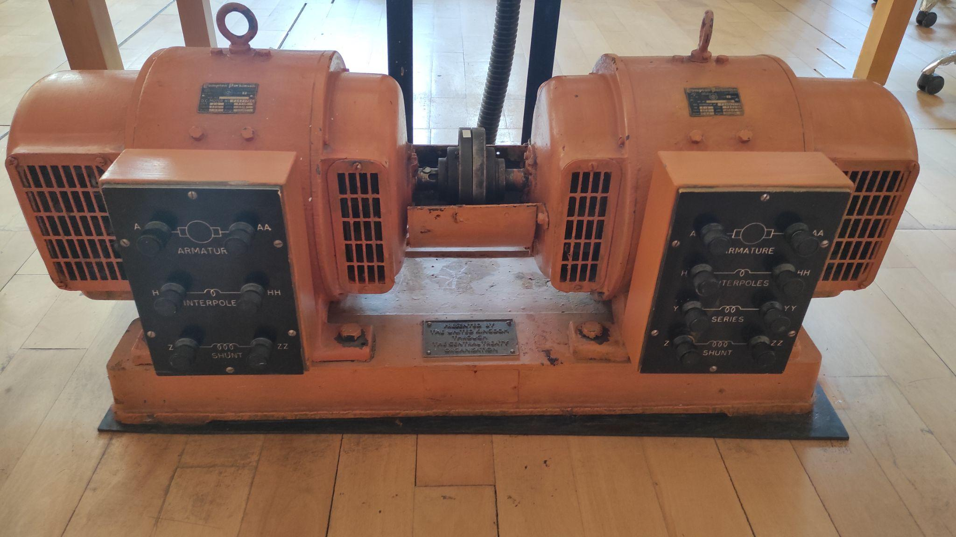
Problem Definition
Power Input: 3 Phase, or 1 Phase AC Grid (Adjustable with variac)
Output: Adjustable DC Output (Vout,max = 180 V)

Slide 4
Topology Selection
Low Ripple - Expensive
High Voltage - Synchronization
No Third Harmonics - 6 Gate Signal
Three Phase Thyristor Rectifier
Single Phase Thyristor Rectifier
Diode Rectifier + Buck Converter
High Ripple + Low Cost
Low output Voltage
Low Ripple + More Efficient
High Voltage + Easy Speed Control
No Third Harmonics

Slide 5
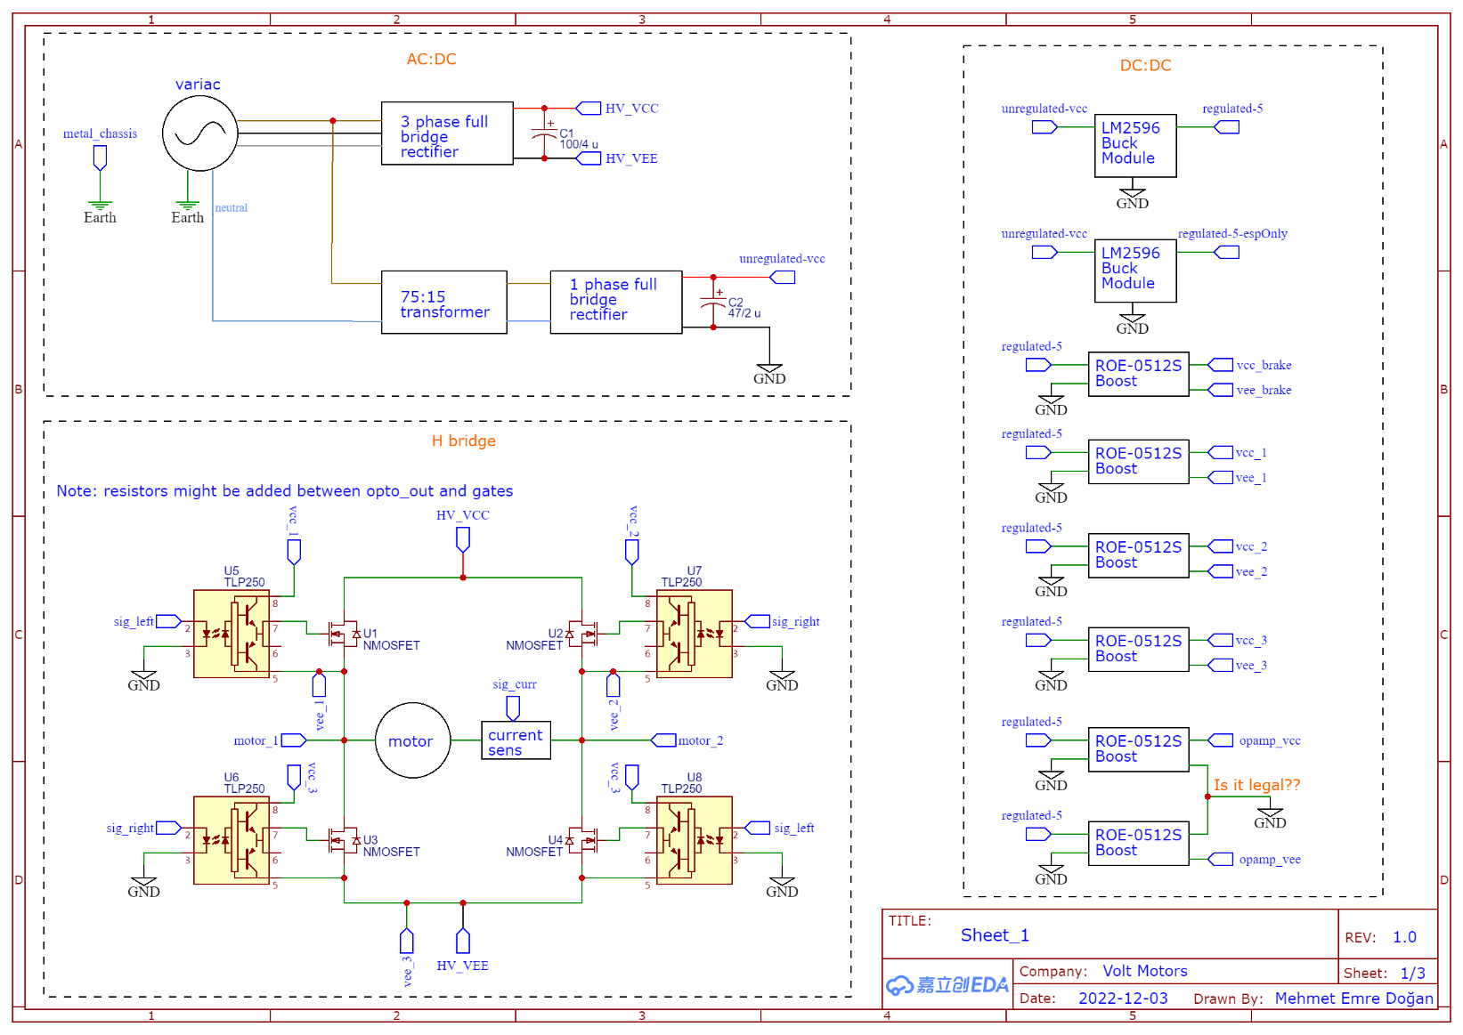

Slide 6
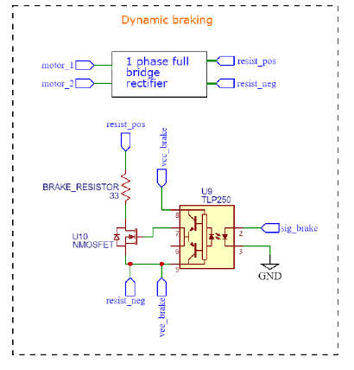
Resistor is externally connected via banana plugs

Slide 7
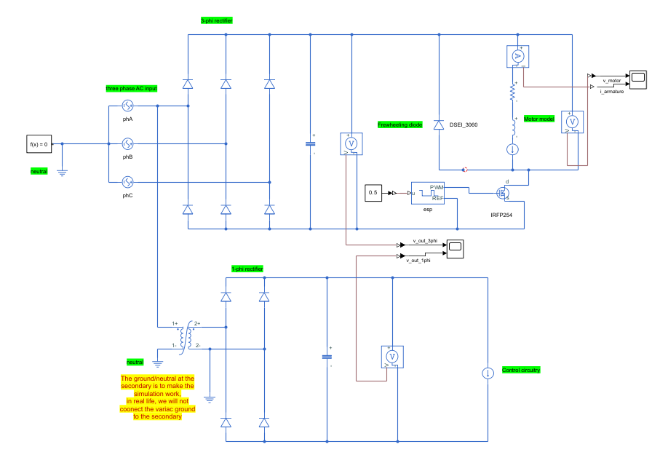
Simulation Result
Simulation Circuitry

Slide 8
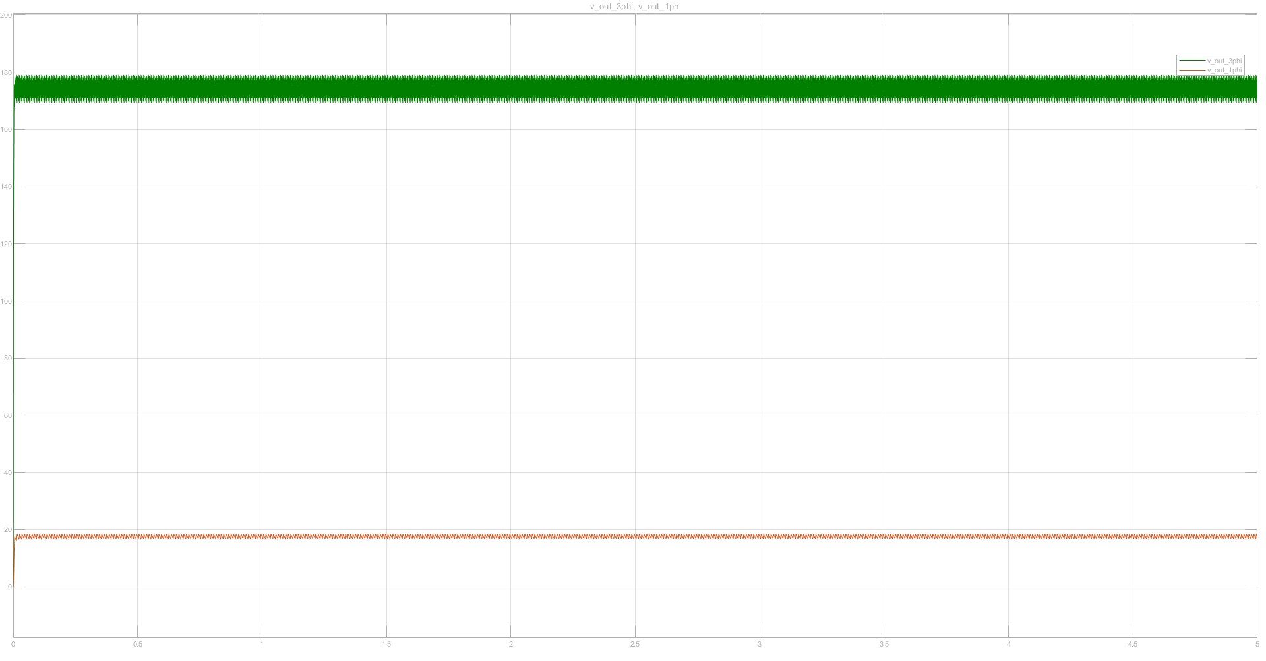
Simulation Result
Stability Simulation of Rectifiers

Slide 9
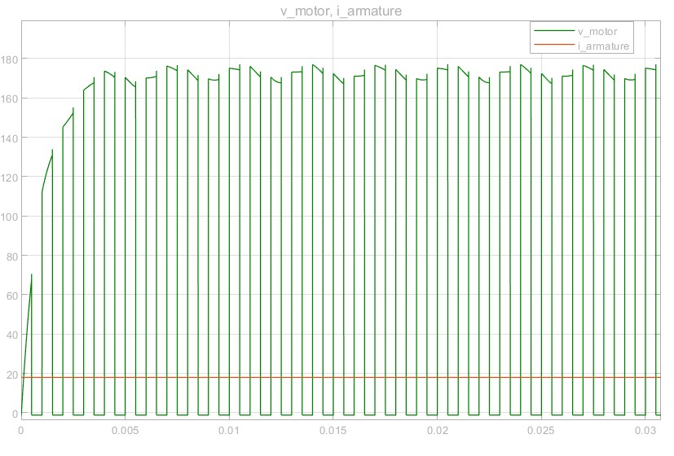
Simulation Result
Terminal Rating of DC Motor After PWM Signal

Slide 10

Targeted Bonuses
Tea Bonus
PCB Bonus
Efficiency Bonus
Industrial Design Bonus
Single Supply Bonus
Closed-Loop Voltage/Current Control Bonus
Closed-Loop Speed Control Bonus
Four-Quadrant Bonus

Slide 11
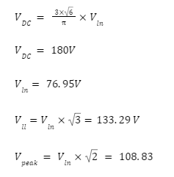
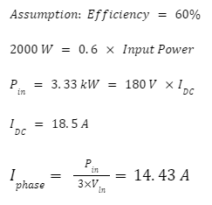
Calculations

Slide 12
Component Selection
Bridge Rectifier | 36MT160 | 1600V | 35A
MOSFET | LSIC1MO120E0080 | 1200V | 39A (25 °C)
Diode | DSEI30-06A | 600V | 37A
Capacitor | K754001020PM0E050 | 400V | 1000uF
Current Sensor | ACS714 | ∓30A
Infrared Distance Sensor

Slide 13
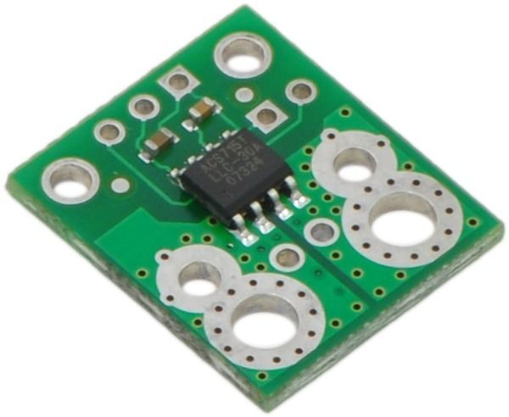
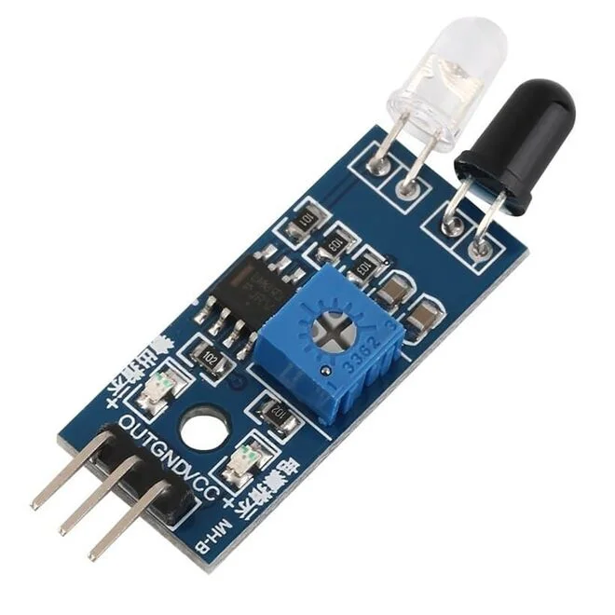
Current Sensor
Infrared Distance Sensor

Slide 14
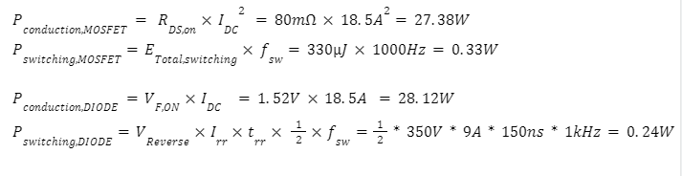
Thermal Calculations

Slide 15




Conclusion
PCB Design
Thermal Analysis
Implementation
Tests

